Slide 1
Database Systems (CSF212) Lecture 11 - 12

Slide 2
E-R Diagrams

Slide 3
Overview of Database Design
Conceptual design
Use ER diagrams
Pictorial representation of DB schema
What are the entities and relationships in the enterprise?
E.g. customer & account entity; deposit relationship
What information about the entities and relationships should we store in DB?
What are the integrity constraints or business rules that hold?
Logical design
Transform conceptual schema into implementation model
e.g., map an ER diagram into a relational schema
Physical design and database tuning
Notes:
2

Slide 4
Entity-Relationship Model
Entity Sets
Relationship Sets
Mapping Constraints
Keys
Participation Constraints
E-R Diagram
Extended E-R Features
Design of an E-R Database Schema
Reduction of an E-R Schema to Tables

Slide 5
Entity and Entity Sets
A database can be modeled as:
a collection of entity sets each of which contains any number of entities,
relationship among entities.
An entity set is a set of entities of the same type that share the same properties.
Example: set of all customers, accounts
An entity is an object that exists and is distinguishable from other objects e.g., set of all customers of a bank, set of all account numbers
Are associated with a set of attributes e.g., name, ID, dept_name, etc.

Slide 6
Entity and Entity Sets
Attributes are associated with a set of permitted values known as domain of that attribute
Every entity is described by a set of (attribute, value) pairs, one pair for each attribute of the entity set
If an entity set customer is associated with attributes name, ID, phone-no, city then {(name, John), (ID, 123456), (phone-no, 9999988888), (city, New york)} describes a particular entity in the set

Slide 7
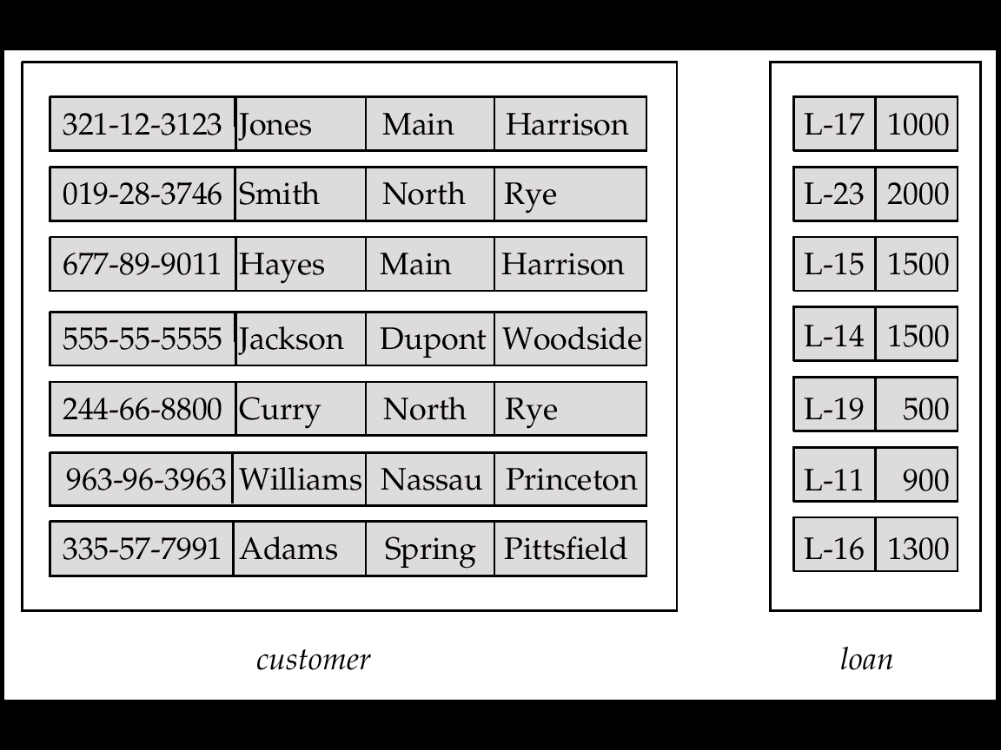
Entity Sets customer and loan
customer customer customer customer loan amount id name street city number

Slide 8
Attributes
Attribute types:
Simple: Atomic valued attribute which cannot be divided further. E.g., phone-no
Composite: Made up of more then one atomic valued attribute. E.g., Name attribute having first name and last name
Single-valued: Attribute that can have only a single value
they can be either simple or composite

Slide 9
Attributes
Multi-valued: Attributes that can have many values E.g. multi-valued attribute: phone-numbers
Derived: Can be computed from other attributes
Are not stored in the database
E.g. age, given date of birth

Slide 10
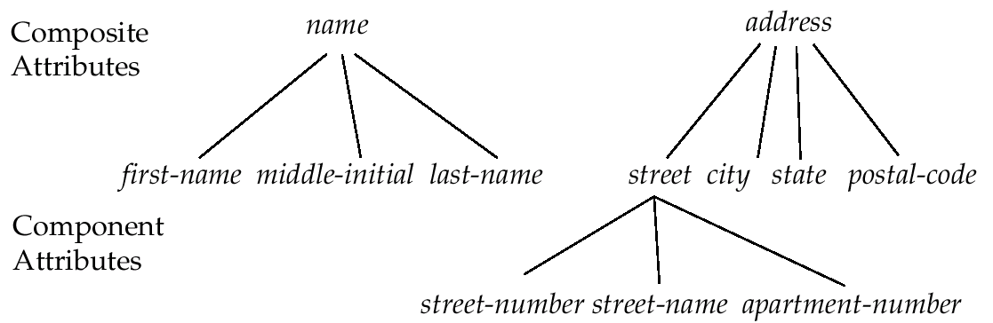
Composite Attributes

Slide 11
Relationship Sets
Relationship: Association among several entities
Example: Hayes depositor A-102 customer entity relationship set account entity
A relationship set is a mathematical relation among entities {(e₁, e₂, … e_{n}) | e₁ ∈ E₁, e₂ ∈ E₂, …, e_{n} ∈ E_{n}} where (e₁, e₂, …, e_{n}) is a relationship
Example:
(Hayes, A-102) ∈ depositor

Slide 12
Degree of a Relationship Set
Refers to number of entity sets that participate in a relationship set.
Binary Relationship sets
Involve two entity sets
Most relationship sets in DB
N-ary Relationships (N >=1)
Can be converted to binary relations
E.g. Two binary relationships, mother and father, relating a child to her farther and mother vs. one ternary relationship parent

Slide 13
Constraints: Mapping Cardinalities
Express the number of entities to which another entity can be associated via a relationship set
Represented by drawing either a directed line (→), signifying “one,” or an undirected line (—), signifying “many,” between the relationship set and the entity set
For a binary relationship set the mapping cardinality must be one of the following types:
One to One
Many to One
Many to Many

Slide 14
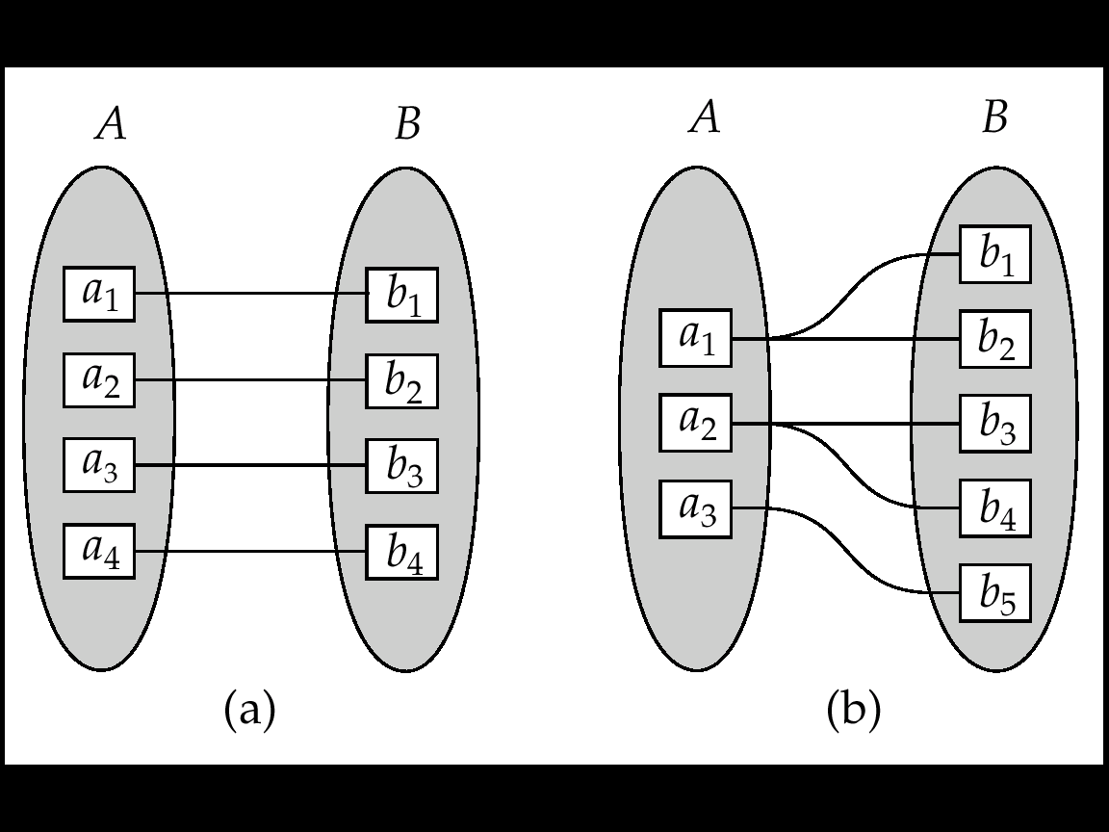
Mapping Cardinalities
One to one
One to many

Slide 15
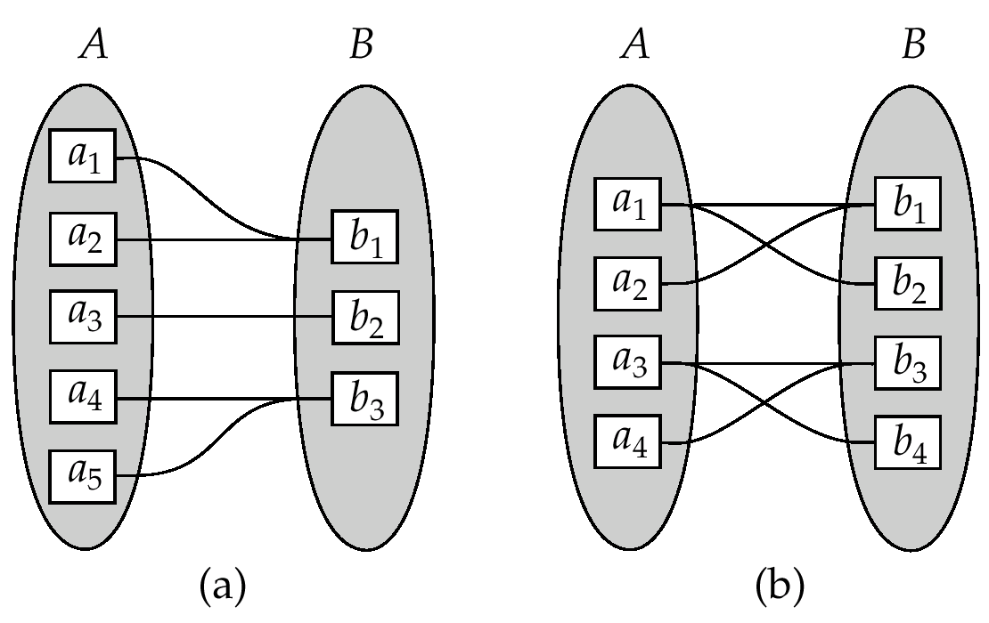
Mapping Cardinalities
Many to One
Many to Many

Slide 16
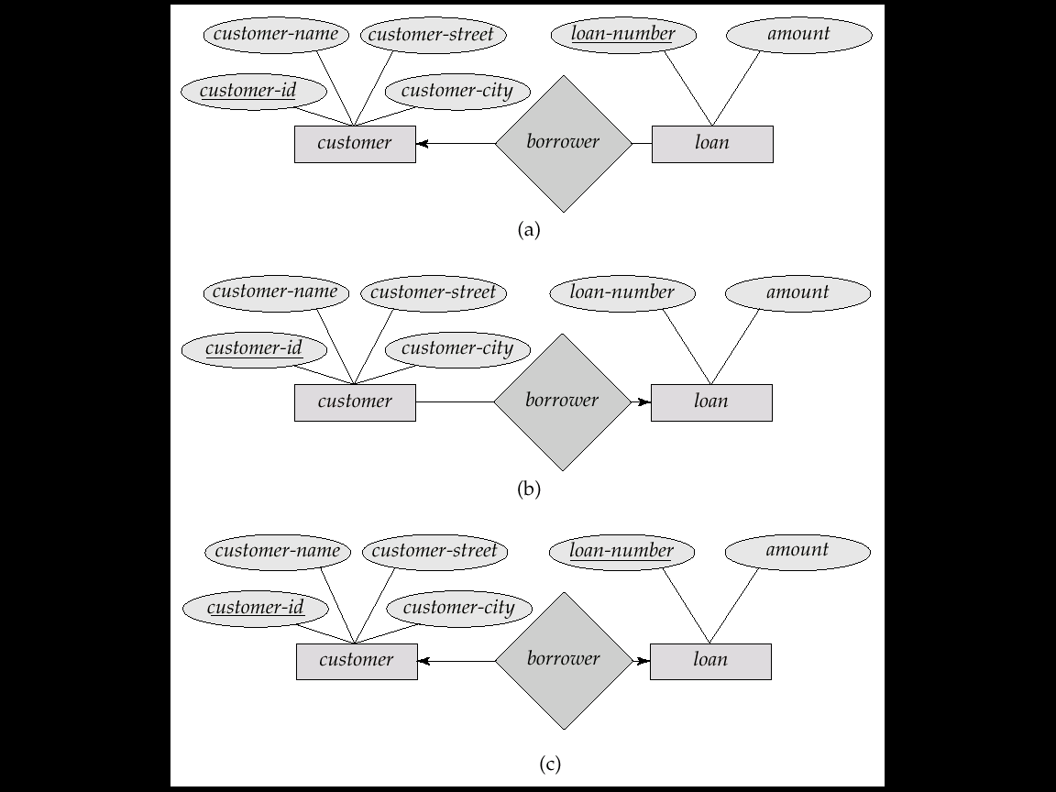
One to One Cardinality Constraint
Example
A customer is associated with at most one loan via the relationship borrower
A loan is associated with at most one customer via borrower

Slide 17
Many to One Cardinality Constraint
Example
In a many-to-one relationship a loan is associated with several (including 0) customers via borrower,
A customer is associated with at most one loan via borrower

Slide 18
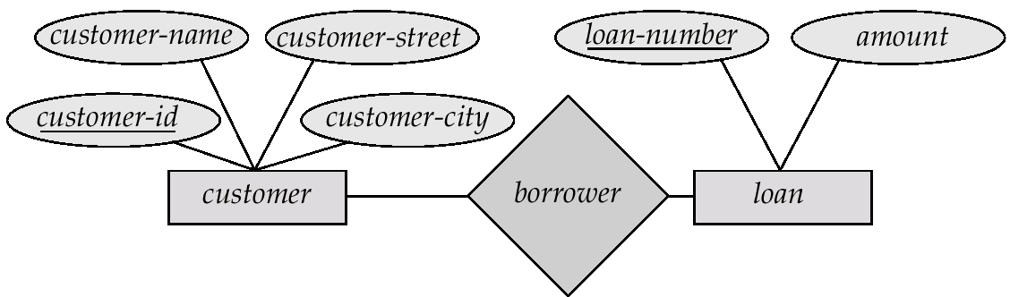
Many to Many Cardinality Constraint
Example
A customer is associated with several (possibly 0) loans via borrower
A loan is associated with several (possibly 0) customers via borrower

Slide 19
E-R Diagram
Rectangles represent entity sets.
Diamonds represent relationship sets.
Lines link attributes to entity sets and entity sets to relationship sets.
Ellipses represent attributes
Double ellipses represent multivalued attributes.
Dashed ellipses denote derived attributes.
Underline indicates primary key attributes

Slide 20
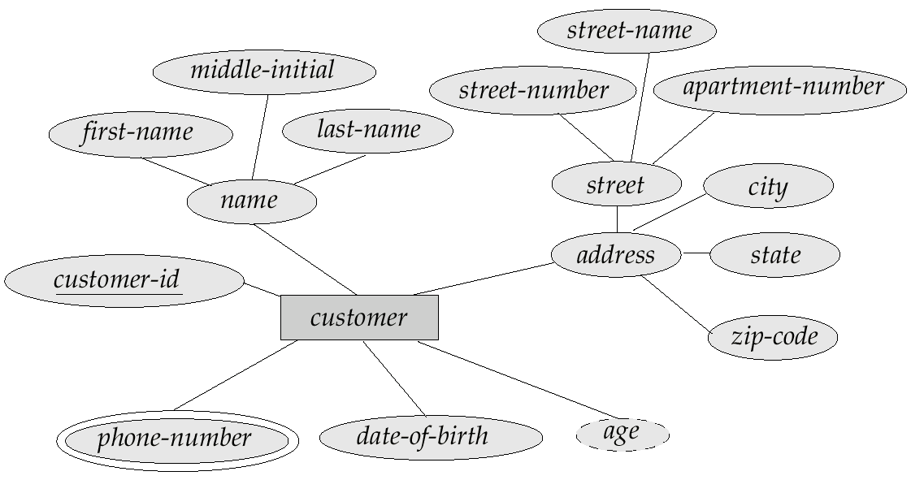
E-R Diagram With Composite, Multi-valued, and Derived Attributes

Slide 21
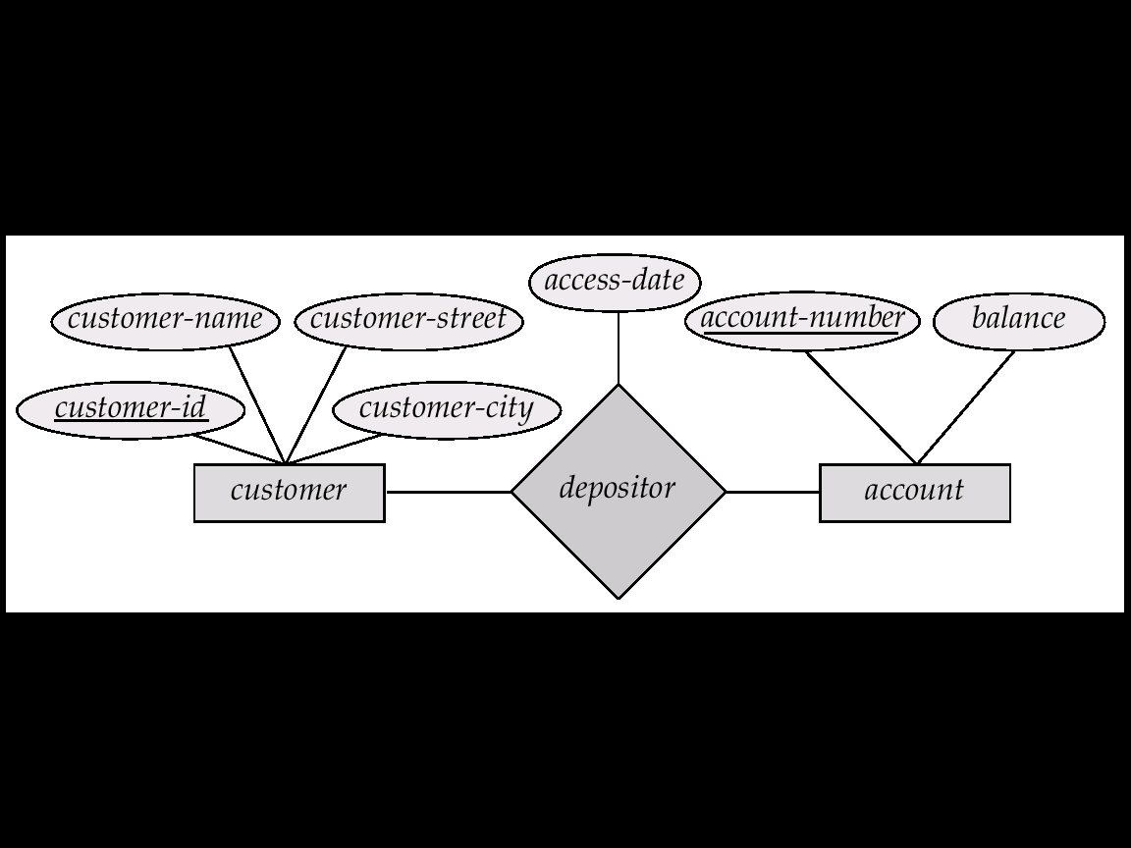
Relationship Sets with Attributes

Slide 22
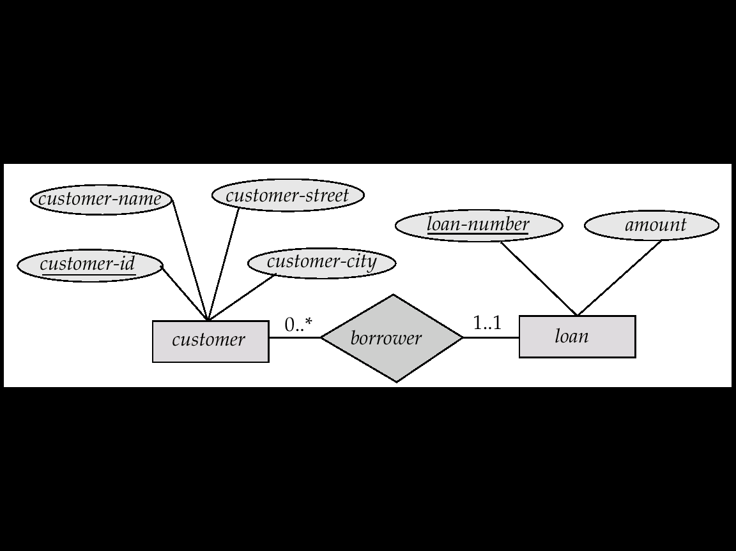
Alternative Notation for Cardinality Limits

Slide 23
Existence dependency constraints
Existence-dependent: Existence of entity x depends on the existence of entity y
y is said to be dominant entity and x is said to be subordinate entity
if y is deleted, so is x. Vice-versa is not mandatory
e.g., account and transaction.

Slide 24
Keys

Slide 25
Keys in Entity Sets
A super key of an entity set
A set of one or more attributes whose values uniquely determine each entity
E.g. customer_id & customer_name
A candidate key
A minimal super key
Customer id is candidate key of customer
Account-number is candidate key of account

Slide 26
Keys in Entity Sets
A super key of an entity set
A set of one or more attributes whose values uniquely determine each entity
A candidate key
A minimal super key
Customer id is candidate key of customer
Employee(ID, name, res_phone_no).
super key = {{ID}, {ID, name}, {ID, res_phone_no},
{name, res_phone_no}, {ID, name, res_phone_no}}
candidate key = {{ID}, {name, res_phone_no}}

Slide 27
Keys in Entity Sets
Primary key: Candidate key chosen to uniquely identify a record in a relation
weak entity set: Entity set does not have sufficient attributes to form a primary key
strong entity set: Entity set having a primary key
E.g., consider the transaction entity set having three attributes: transaction-number, date and amount

Slide 28
Weak Entity Sets
An entity set that does not have a primary key
The existence of a weak entity set depends on the existence of a identifying entity set
It must relate to the identifying entity set via a total, one-to-many relationship set from the identifying to the weak entity set
Identifying relationship depicted using a double diamond
Discriminator (or partial key): May not uniquely identify entities of a weak entity set, but can be combined with the primary key of a strong entity set to uniquely identify entities of the weak entity set
The primary key of a weak entity set
primary key of the strong entity set + weak entity set’s discriminator.

Slide 29
age
E_name
name
DateOfBirth
E_ID
has
Employee
child
strong entity
weak entity
Primary Key(Employee) = {E_ID} // represented by solid lines
Partial Key(child) = {name} // Represented by dashed lines. Two employees can have child of same name, age and DateOfBirth
Primary Key(child) = {E_ID, name}

Slide 30
date
branch
t_no
amount
account_ID
has
Account
Transaction
strong entity
weak entity
Primary Key(Account) = {account_ID}
Partial Key(Transaction) = {t_no} // Although t_no can uniquely identify the records in transaction entity set, transaction entity set does not have any existence without account entity set
Primary Key(Transaction) = {account_ID, t_no}

Slide 31
Participation of an Entity Set in a Relationship Set
Total participation (indicated by double line): Every entity in the entity set participates in at least one relationship in the relationship set
E.g. Participation of loan in borrower is total
every loan must have a customer associated to it via borrower
Partial participation: some entities may not participate in any relationship in the relationship set
E.g. participation of customer in borrower is partial

Slide 32
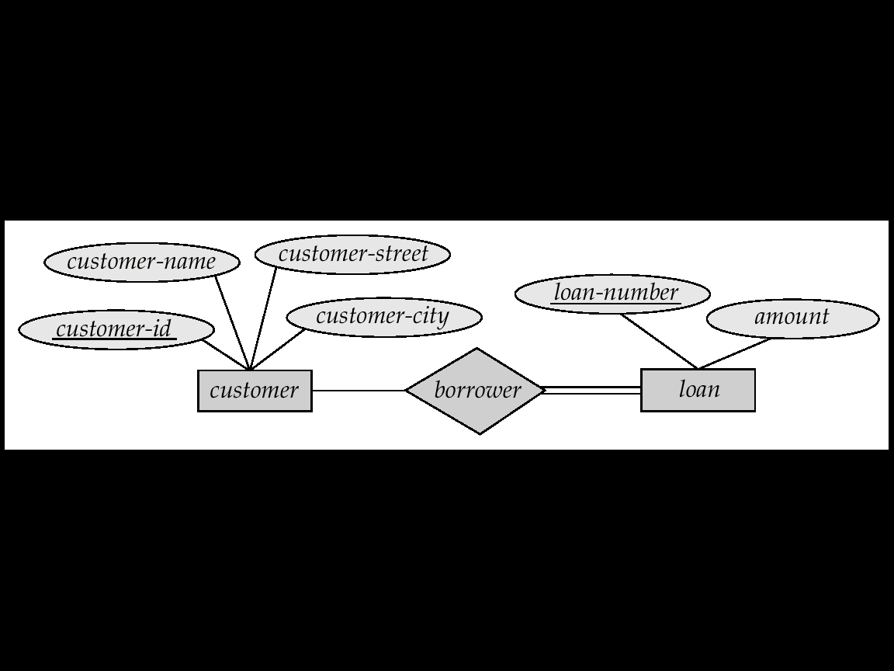
Participation of an Entity Set in a Relationship Set
Every entity in loan should be associated with some entity in customer through borrower relationship, but vice-versa may not be true.

Slide 33
Keys for Relationship Sets
Let R be a relationship set involving entity sets E1, E2, … En.
If R has no attribute of it’s own then
attribute(R) = Primary-key(E1) U primary-key(E2) … U primary-key(En)
If R has it’s own attribute set {a₁, a₂,..a_{m}}
attribute(R) = Primary-key(E1) U primary-key(E2) … U primary-key(En) U {a₁, a₂,..a_{m}}

Slide 34
Keys for Relationship Sets
Primary key of relationship sets depends on:
Mapping cardinality
Structure of the attributes associated with the relationship set
If the relationship set R has no attribute:
Superkey(R) = attribute(R)
If mapping cardinality is many-to-many, then Primarykey(R) = Superkey(R)
If mapping cardinality is many-to-one, then the primary key of the entity associated with many is the superkey of R

Slide 35
Keys for Relationship Sets
If the relationship set R has it’s own set of attributes then super key is formed as before, with the possible addition of one or more of these attributes

Slide 36
ER Diagrams to Relational Schema

Slide 37
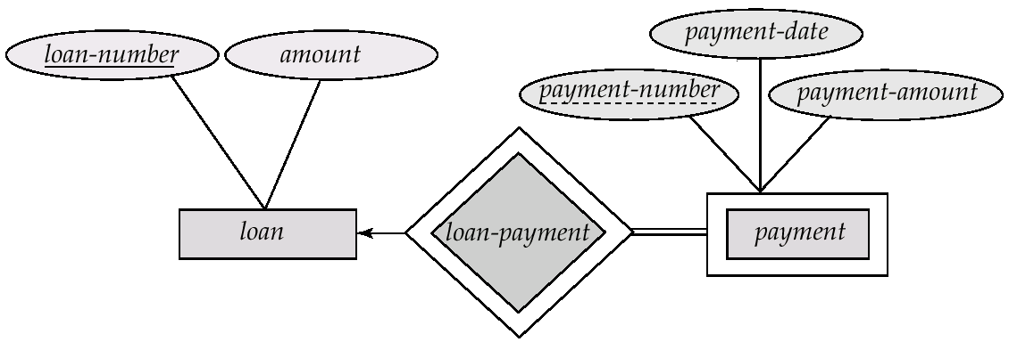
Representation of Strong Entity sets
Let E be a strong entity set with attributes a₁, a₂, … a_{n} then:
E is represented by a table named as E with n distinct columns
Each of row of E represents one entity of the set

Slide 38
Representation of Strong Entity sets
loan
Loan_number | Amount
loan = {(L_1, 1000), (L_2, 2000), (L_3, 3000)}
loan
loan_number | Amount
L_1 | 1000
L_2 | 2000
L_3 | 3000

Slide 39
Representation of Weak Entity sets
Let A be a weak entity set with attributes a₁, a₂, … a_{n} and B be the strong entity set on which A is dependent. Let the primary key of B be {b₁, b₂, … b_{m}}, then:
A is represented by a table named as A with one column for each attribute of the set
{a₁, a₂, … a_{n}} U {b₁, b₂, … b_{m}}
Each of row of E represents one entity of the set

Slide 40
Representation of Weak Entity sets
payment
payment_number | payment_date | payment_amount | loan_number

Slide 41
Representation of Relationship Sets
Let R be a relationship set involving entity sets E₁, E₂, … E_{m}. Let attribute(R) consists of n attributes. Then:
R is represented by a table called R with n distinct columns

Slide 42
Representation of Relationship Sets associating Strong Entity Sets
attribute(depositor) = {customer_id, account_number, access_date}
depositor
customer_id | account_number | access_date

Slide 43
Representation of Relationship Sets Associating Strong and Weak Entity Sets
payment
payment_number | payment_date | payment_amount | loan_number
attribute(loan-payment) = {loan_number, payment_number
loan-payment
loan_number | payment_number
Redundant information, already present in payment table. Therefore no need to store

